Slide 1
NLP 2

Slide 2
NLP includes NLU and NLG
NLU
Natural language understanding
NLP
Natural language processing
NLG
Natural language generation
Takes up the understanding of the data based on grammar, the context in which it was said and decide on intent and entities
NLP converts text into structured data.
A software process that automatically transforms structured data into plain-English content. NLG can actually tell a story – exactly like that of a human analyst – by writing the sentences and paragraphs for you.

Slide 3
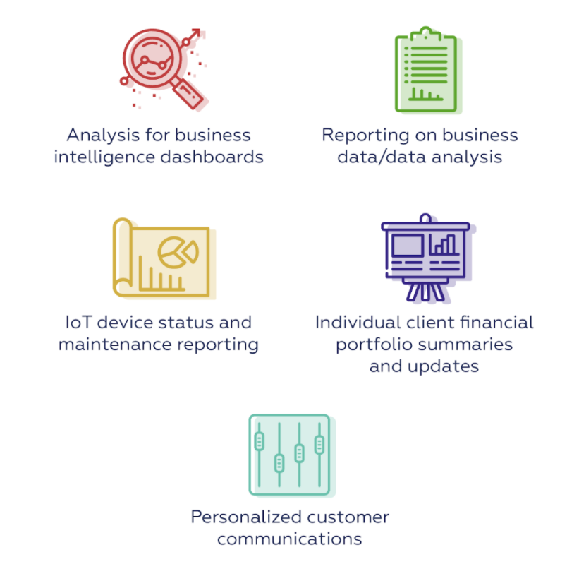
Practical applications of NLG
Source: https://medium.com/sciforce/a-comprehensive-guide-to-natural-language-generation-dd63a4b6e548

Slide 4

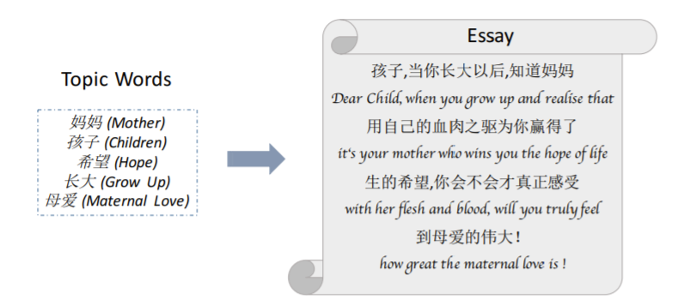
We will apply NLG for
Building a chatbot
Essay writing
Language translation
Source: Feng, Xiaocheng, et al. "Topic-to-Essay Generation with Neural Networks." IJCAI. 2018.

Slide 5


Slide 6
NLG is all about making choices:
Content to be included/omitted
Organization of content into a coherent structure
Style (formality, opinion, genre, personality...)
Packaging the content into sentences
Syntactic constructions:
How to refer to entities -- referring expression generation
What words to use -- lexical choice

Slide 7

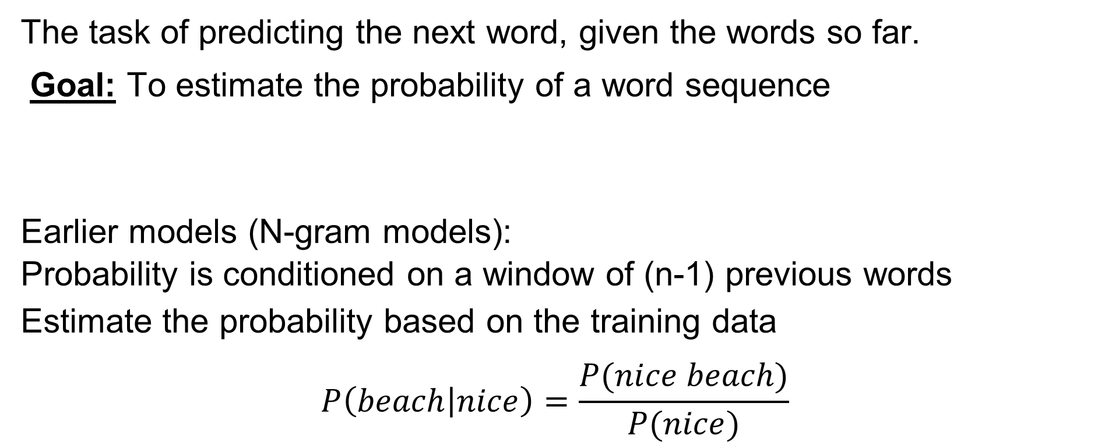
Language model:
The task of predicting the next word, given the words so far.
Goal: To estimate the probability of a word sequence
Earlier models (N-gram models):
Probability is conditioned on a window of (n-1) previous words
Estimate the probability based on the training data
$$P\left(beach | nice\right)=\frac{P(nice beach)}{P(nice)}$$

Slide 8
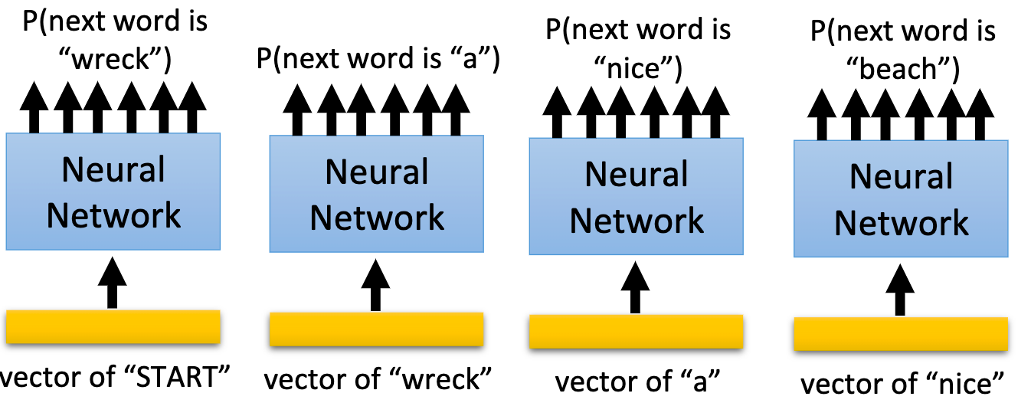

NN-based language model
$$P(“wreck a nice beach”) = P(wreck|START)P(a|wreck)P(nice|a)P(beach|nice)$$

Slide 9
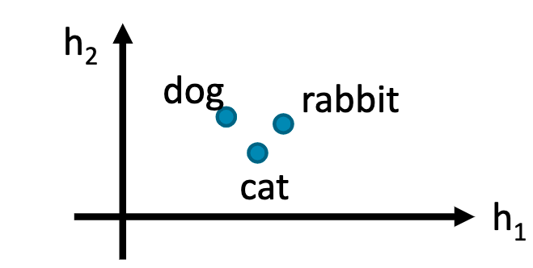
NN-based language model
Word embedding input
If the input layer (or hidden layer) of two related words(cat and dog) are close and P(jump|dog) is large,
P(jump|cat) will be large as well (even if “... cat jump ...” is not present in the data)

Slide 10
Deep learning models for text data
Neural networks
Ordinary feed forward neural networks (could be deep with multiple internal nodes and layers)
Recurrent neural networks (with attention)
Use input data in sequential order, uses information about the ordering of tokens.
Convolutional neural networks
1-d CNN neural networks can selectively use information from previous tokens (based on how 1-d filters are defined, can be parallelized in GPU)
Transformers
Fully attention models that consider interaction of other tokens with current token (the model has many parameters and slow to train, but more accurate)

Slide 11
Downstream language generation tasks
We focus on two downstream language generation tasks:
Essay writing -- Text generation
Language translation – using Transformer
Chatbots -- Generating conversations
should be relevant to previous message,
should be relevant to context/personality of the speaker)

Slide 12
Essay Writing

Slide 13
Essay writing
In this project an AI model is going to help you write essays on various topics. The AI model is a machine learning model that generates English language given some initial sentences.
Objective
The aim of the project is to introduce students with the latest technologies in the field of language processing. This project also shows how the latest advancements in machine learning can be used in everyday activities.
Steps:
Select a topic from the available list of topics or choose your any topic.
Fine-tune the AI model using the data from text.
Run the model and use help from AI to complete a meaning essay on the topic.

Slide 14
Transformer

Slide 15
A gentle introduction
Broadly resembles the encoder-decoder architecture
Avoids recurrence/convolution – hence computationally efficient
Less time to train
More parallelizable
Key concepts
Attention
Self-attention
Multi-head attention
Positional encoding

Slide 16
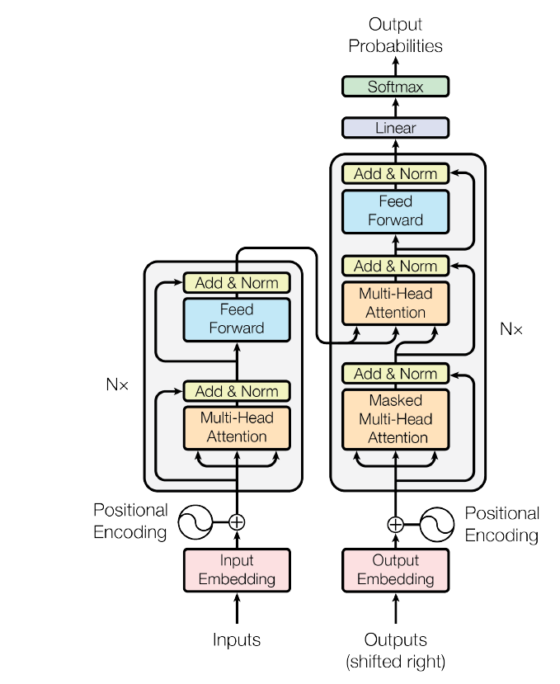
Preparing the input
Source: Attention Is All You Need by Vaswani et al

Slide 17
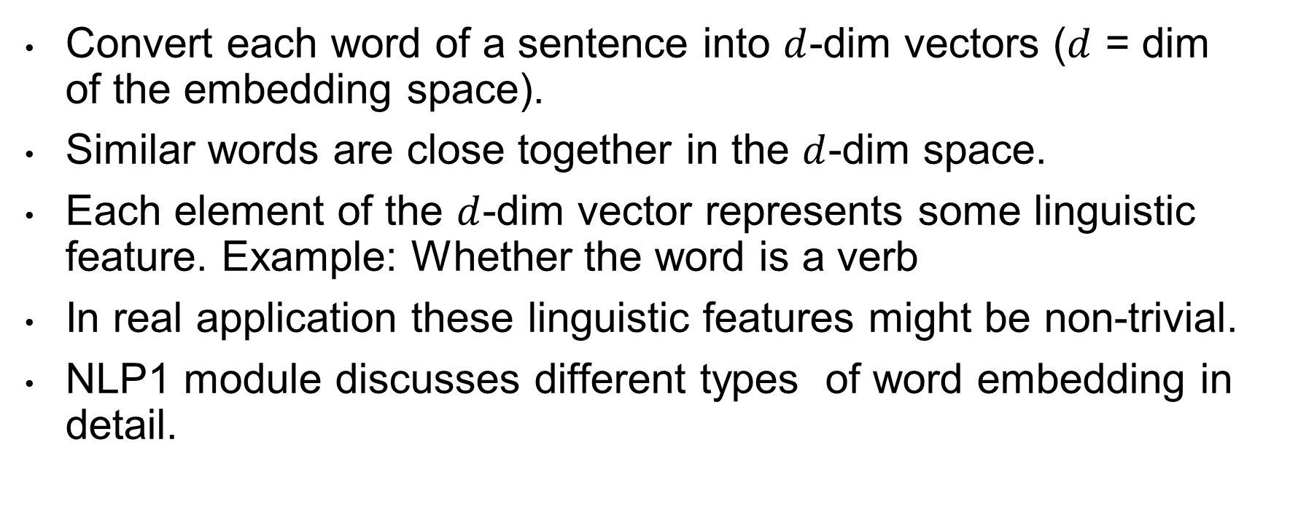
Word embedding
Convert each word of a sentence into $d$-dim vectors ($d$ = dim of the embedding space).
Similar words are close together in the $d$-dim space.
Each element of the $d$-dim vector represents some linguistic feature. Example: Whether the word is a verb
In real application these linguistic features might be non-trivial.
NLP1 module discusses different types of word embedding in detail.

Slide 18

Illustration (word embedding)
Twinkle twinkle little star how I wonder what you are
.2
.13
.46
.74
.83
.2
.13
.46
.74
.83
.3
.1
.2
.4
.18
Converting each word into a vector
Dimension of the embedding space ($d$) = 5

Slide 19
Positional encoding
Goal: To capture positional information
For each word it creates a position vector with no. of dimension same as the number of dimension of the embedding space.
Example:
Even though she did work she is not tired.
Even though she did not work she is tired.
Position of the word “not” changes the both the sentiment and the meaning of the sentence.

Slide 20
Illustration (positional encoding)
Twinkle twinkle little star
.2
.13
.46
.74
.83
.02
.37
.61
.18
.91
.2
.13
.46
.74
.83
.01
.01
.34
.19
.88
.3
.1
.2
.4
.18
.32
.65
.47
.32
.11
.1
.03
.59
.1
.2
.89
.29
.01
.23
.71
Word embedding + Positional encoding = Position aware embedding
This is the INPUT to the model.
Word embedding
Positional encoding

Slide 21
Encoder
Source: Attention Is All You Need by Vaswani et al

Slide 22
Attention mechanism
Quantifies interdependence
Between input and output elements (general attention)
Within the input elements (self-attention)
Example: Self attention
Example: General attention
 | I | am | from | India | and | I | speak | Hindi
I | 1 | .9 | .5 | .1 | .2 | 1 | .3 | .1
Am |  | 1 | .2 | .1 | .3 | .9 | .2 | .2
From |  |  | 1 | .2 | .4 | .1 | .2 | .1
India |  |  |  | 1 | .1 | .1 | .2 | .9
And |  |  |  |  | 1 | .4 | .1 | .1
I |  |  |  |  |  | 1 | .3 | .2
Speak |  |  |  |  |  |  | 1 | .3
Hindi |  |  |  |  |  |  |  | 1
I am from India and I speak
Hindi
Input
Output
Pay more attention to the words that are important in making this prediction

Slide 23
Multi-headed attention
Multi-headed attention
Attention filter 1* Input = Output 1
Attention filter 2* Input = Output 2
Attention filter 3* Input = Output 3
Attention filter 4* Input = Output 4
Attention filter 5* Input = Output 5
Concatenate these outputs
FFNN
Encoder output
Projects the output in a lower dim space
5 heads corresponds to 5 attention filters
Different filters focus on different parts of the sentence

Slide 24
Decoder
Source: Attention Is All You Need by Vaswani et al

Slide 25
Decoder architecture
Output probabilities
Multi-headed attention
Encoder output
Masked multi-headed attention
Masked attention restricts viewing the future words in the actual output sequence.
For example: While predicting the 4-th word it can see up to 3rd word.
Twinkle twinkle little star how I wonder
Output word embedding + position encoding

Slide 26
GPT-2 Transformer language model(OPEN-AI)
GPT-2 is a large transformer-based language model with 1.5 billion parameters, trained on a dataset of
40GB of Internet text.
Trained on selected Reddit pages:
They created a new dataset which emphasizes diversity of content, by scraping content from the Internet.
GPT-2 is trained with a simple objective: predict the next word, given all of the previous words within some text.

Slide 27
Chatbots

Slide 28
Chatbots
Business Insider experts predict that by 2020, 80% of enterprises will use chatbots.
According to Lauren Foye, by 2022, banks can automate up to 90% of their customer interaction using chatbots.
A survey conducted by Spiceworks showed that 40% of large companies employing more than 500 people plan to implement one or more intelligent assistant or AI-based chat robot over corporate mobile devices in 2019.

Slide 29
Chat bots
Dialog datasets are small and it’s hard to learn enough about language and common-sense from them to be able to generate fluent and relevant responses.
Start by pretraining a language model on a very large corpus of text to be able to generate long stretches of contiguous coherent text,
Fine-tune this language model to adapt it to our end-task: dialog

Slide 30
Transfer learning
Pretraining: Training the model on a very large corpora
Fine-tuning: Tune the model on smaller dataset (B) which is not the same as (A)
A
B

Slide 31
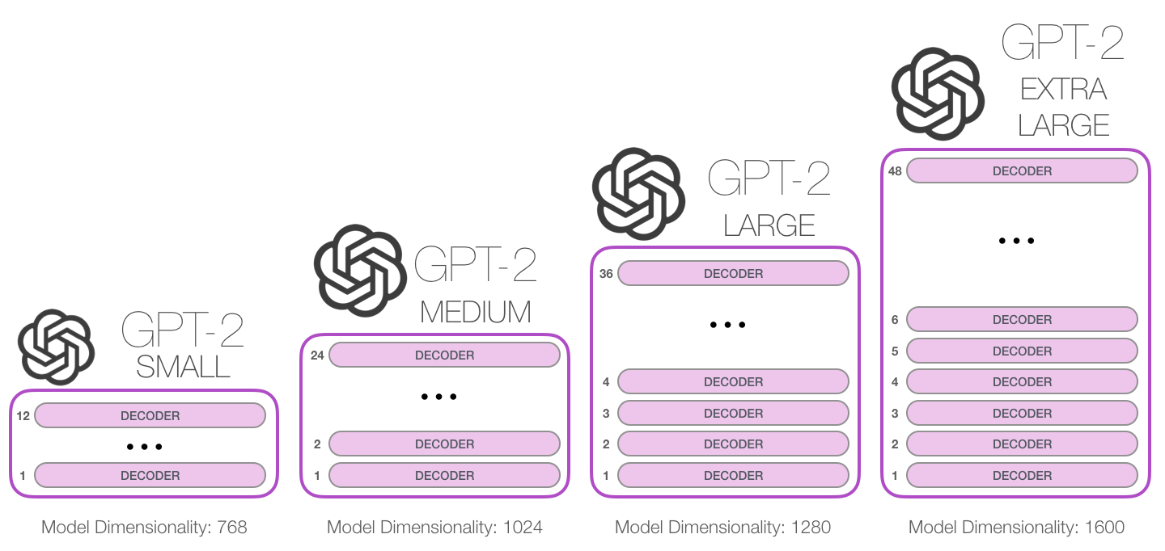

Slide 32

DialoGPT (MICROSOFT)
Dialog model fine tuned from GPT2
The model is trained on 147M multi-turn dialogue from Reddit discussion thread. The largest model can be trained in several hours on a 8 V100 machines (however this is not required), with distributed training and FP16 option.

Slide 33
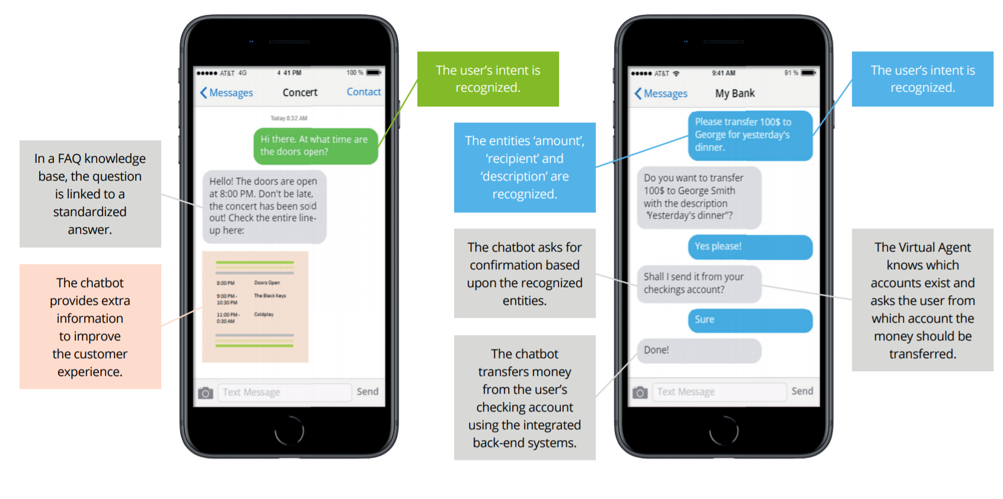

Slide 34
Chatbot Characteristics
Intent Recognition Ability to “guess” what the user is requesting, even if phrased unexpectedly. Good intent recognition is vital if you don’t want to annoy your users.
Dialog Management Go beyond simple Q&A and enable your Chatbot to have complex and meaningful conversations with the user.
Humanization Users get more engaged in conversation if a Chatbot acts more humanlike. Some Chatbots are able to detect and show emotions.
Interaction Channels How will users interact with your Chatbot? Choose a platform that connects easily with your webchat, app, social media platform or voice interface.
Notes:
There is a big variety in Chatbot development platforms. Below are a number of characteristics that should be taken into account when choosing the suitable platform to implement with your Chatbot.

Slide 35
Chatbot Characteristics continued…
Task Automation Capability Does your Chatbot need to perform tasks for users? Make sure it has enough dialog capabilities and that it can connect to your back-end systems
Reporting & Monitoring Are your customers being helped? Are they happy? Does your contact center get less calls? Choose a Chatbot platform that tells you how it’s performing.
Ease of Implementation Some platforms require custom software development, while others allow business users to configure the Chatbot themselves.
Security & Compliance Do you have extra security requirements? Or do you need to be compliant with audit regulations? Security and logging capabilities can vary.

Slide 36
Thank you!
Questions? Comments?

